Slide 1
Welcome To Grade 3/4 L.A. 18
Mr Matthew Bennett and Ms Val Bell
Landsdale Primary School 2015

Slide 2
My Beliefs/My Background
Children need to be safe and supported
They need to be engaged
I believe in cooperative learning
I firmly believe in open communication between me, home and the classroom
Children need to be independent thinkers

Slide 3
Literacy
Speaking & Listening – debating
Writing – gradual release – focus on exposition and narrative
Spelling, Grammar and Punctuation
Reading – whole school and in class focus on inferring and fluency (reading between the lines, automaticity, paying attention to punctuation)
Heavy focus on group work
Spelling – Targeted, Diana Rigg approach – synthetic phonics – students grouped according to spelling age
Explicit teaching of punctuation and grammar + spelling concepts
Practice and Guided Reading to occur during rotations
Notes:
Speaking and Listening: News and Show & Tell, Explaining and sharing their work, readers theatre.
Writintg: Focus in Term 1 is on narrative. Structure and paragraphing are a focus
Spelling Etc: Daily work, different activities on rotation every day. Targeted to the individual needs of the student.
Reading: Different activities every day on rotation at students ability level.

Slide 4
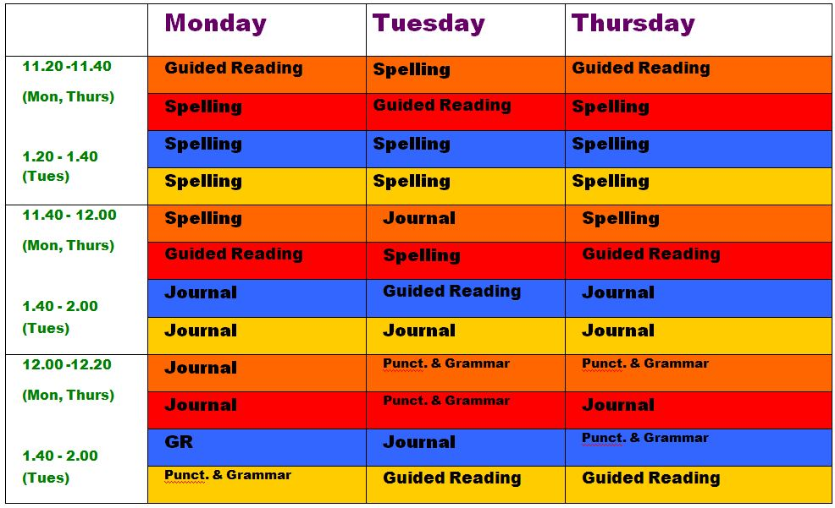
Literacy Rotations
Format to look very much like this:

Slide 5
Numeracy
Mental maths every day before school – learning mental strategies + problem solving techniques
We are using a series of books called Stepping Stones - I.T. Based
Rotations – targeted teaching of students at level, fluid groupings, teachers regularly review
3s go to Ella Marion and...
Notes:
Numeracy

Slide 6
NAPLAN
For the Year 3s, this is a NAPLAN year, and as such I will be working towards giving each child the skills and strategies they will need to achieve their best in this important assessment.

Slide 7
Science
Topic: Natural and Processed Materials
Series of activities to facilitate investigating and learning about the scientific method
3s to be taught Science by Val Bell, 4s by Matt

Slide 8
Society & Environment
Two distinct areas of focus, both research based:
Year 3: Celebrations around the world and in Australia – why do we celebrate such events, including multi-cultural events, in Australia?
Year 4: The First Fleet

Slide 9
1 to 1 Laptop Program
Year 4 students are invited to participate by purchasing an Apple Mac laptop which can be purchased at a discount through the school and a company called Winthrop.
Presents many opportunities for students and will be utilised often in classroom , although opportunities to this point have necessarily been limited due to agreements still not having been received (this will change)
Incredible opportunity – this is the future and our school is embracing it – I have not seen this type of forward-thinking approach elsewhere
Examples of use: Mathletics, Spellodrome, emailing, e-documents and digital literacy, research, Reading – unlimited.

Slide 10
Homework
Weekly, starting in Week 3
Reading a Home Reading book 10-15 minutes per night (I will explain why)
Spelling 5-10 minutes per night on list words – focus on phonics concepts, syllabification and separating phonemes – this may, at some point, be replaced by Spellodrome – more to come on this and I will let you know if and when
Mathletics - 5 minutes per night – set program
Mathletics works – proven positive effect on NAPLAN results
Parents to sign to verify that this has been done

Slide 11
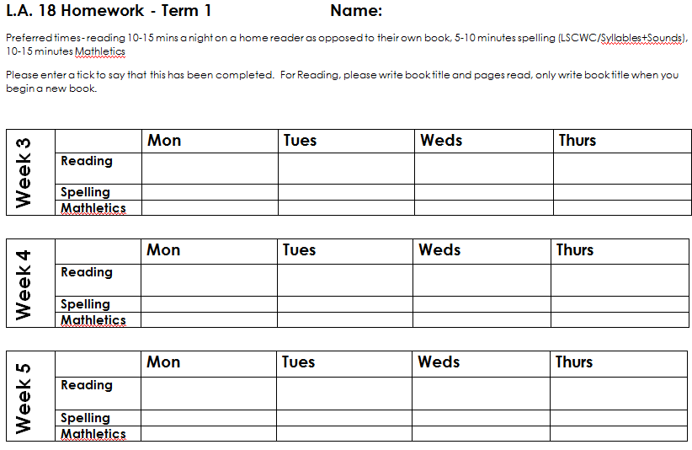
Homework Recording Sheet

Slide 12
Encouragement For Good Behaviour and the School’s Positive Behaviour Focus
Whole school policy is based on a philosophy which says, quite simply, that positive methods are superior to negative when it comes to behaviour management and school is a better place to be because everyone is happier
I Values program – A whole school initiative rewarding children for positive behaviour.
Tokens given out at recess and lunch. Raffle drawn at assembly.
Aim is to encourage students to become happier, more productive students and future good citizens
Attempt to resolve all behaviour with responses as low key as is possible
Classroom meetings
Passport - Good behaviour earns a tick.
5 ticks earns a child a “Dojo Point”, after which further sets of ticks will earn a child silver, then gold – Class Dojo to begin soon after some early teething problems technology wise
Marble jar – when full, class earns a reward.
100 ticks means free time (30 minutes only, directed)

Slide 13
Behaviour Management Policy
Deterrents to Poor Behaviour:
Stage 1: formal warning (name on board)
Stage 2: time out in class
Stage 3: time out in another classroom (partner class), student fills in reflection sheet
Stage 4: child sent to administration
*positivity is preferred!

Slide 14
Diaries and communication
If you would like to write me a note in your student’s diary, please do so
Alternatively – email me at matthew.bennett@education.wa.edu.au
(see notes)

Slide 15
Class Website
I have created a class website which I will add to over time, including examples of students’ work and even, potentially, blogs they have written
Google LA18Landsdale Weebly or follow link

Slide 16
Learning Spaces
Research shows that if students have some choice or autonomy over where they sit to learn, it can have great positive benefits in terms of their educational outcomes.
Students in L.A. 18 have embarked on the process of turning our "standard" classroom, with rows of desks in a relatively traditional set-up, into a set of learning spaces. Students voted on the type of furniture they wanted, namely a small tent to read in, stools to sit on, an outdoor setting and many other bits and pieces. They also designed a room lay-out they preferred using graph paper to construct a birds-eye view of their ideal classroom set-up. The final set-up will be drawn from the best ideas seen in the students' work.

Slide 17
Bits ‘n’ Pieces
Ziptales
Online reading program the school has purchased the rights to.
LEAP (Linking Education and Parents Programme)
A valuable program providing parents with access to many resources which are located in the Information Centre.
For helping parents to reinforce learning at home as well as supporting a positive family environment. Our school newsletter also contains parenting information.
Assembly
LA18 will attend the Senior Assemblies each fortnight. Please check website for dates.
Our class will host the assembly in term 4. More information will be given closer to the time.

Slide 18
Bits ‘n’ Pieces
Crunch and Sip
Students are encouraged to bring in a healthy snack of fruits or vegetables only to eat in class before lunchtime. Please make sure it is cut up into bite size pieces and put in an airtight container.
Students are encouraged to bring in a bottle filled with water only to class
each day. These two things have been proven to assist their learning.

Slide 19
Bits ‘n’ Pieces
Australian Curriculum
Available Times – a.m. – appointments preferred
Changes – please advise
Valuables – please do not bring
Encouraging personal responsibility

Slide 20
Bits ‘n’ Pieces
Absences / Illnesses: Please do not send your child to school if they are unwell.
Please arrive at 8.30am - Students need time to settle in the morning and often find that if they are late, they are unorganised. Students who are late must enter the school through the front office. A late note is given which is then taken to the teacher.
A note is required explaining all absences. Please ensure that any notes are clearly dated and signed then given to the teacher as soon as possible.
Medical Issues: Please let us know straight away if there are any medical issues with your child e.g: allergies. Also please let us know if your child is on any medication. If they need to take medication at school please label it very clearly with the dosage, time etc.
School Dress Code and Behaviour: Please support us as we try to develop school pride in the children. We think their appearance and behaviour really help make Landsdale the school it is.

Slide 21
General Questions
Please make an appointment with me for questions regarding any individual child
Please feel free to make an appointment at any time during the term with any concerns you may have – my door is open.

Slide 22
Finally...
Volunteers – especially for reading in the morning, 8.30 – 9.00 a.m.
Indoor plants?

